Slide 1

Sentiment Analysis for Movies Review
Amro Abdelqader
Ashraf Abdulkhaliq

Slide 2
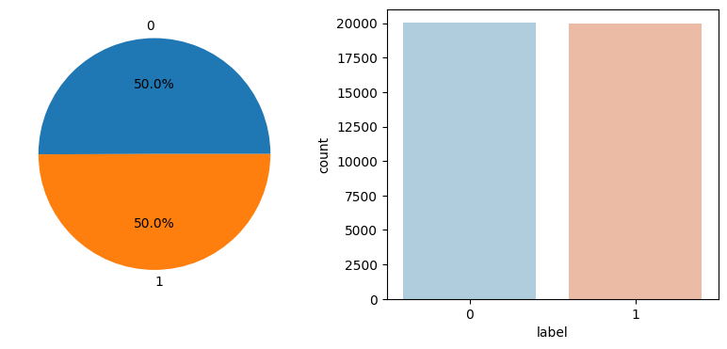
Introduction
The dataset contains 40,000 movie reviews.
Each review is labeled as 1 for a positive review and 0 for a negative review.

Slide 3
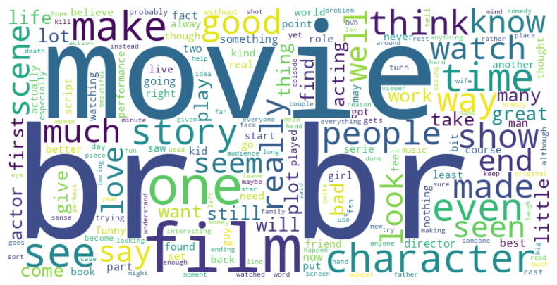
Word cloud
All the movie reviews are long sentences; most of them exceed 200 words in length.

Slide 4

Text cleaning
Lowercasing
Removing special characters, URLs, and user handles
Removing stop words
Stemming

Slide 5
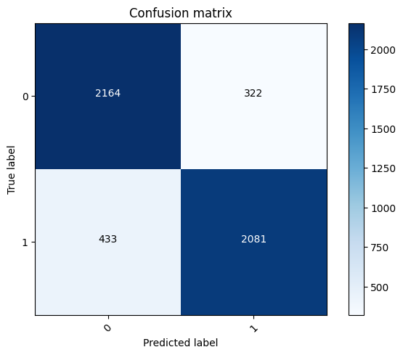
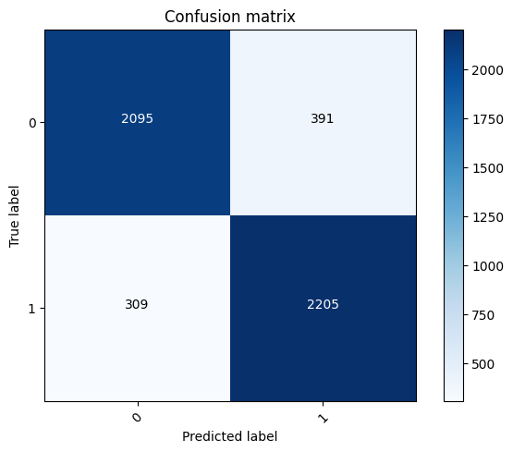
Ml with Bag words
Model | Accuracy | Precision | Recall | F1-score
Naive Bayes | 85% | 85% | 85% | 85%
Passive Aggressive | 86% | 86% | 86% | 86%

Slide 6
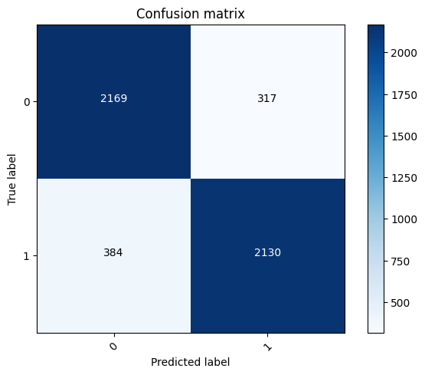
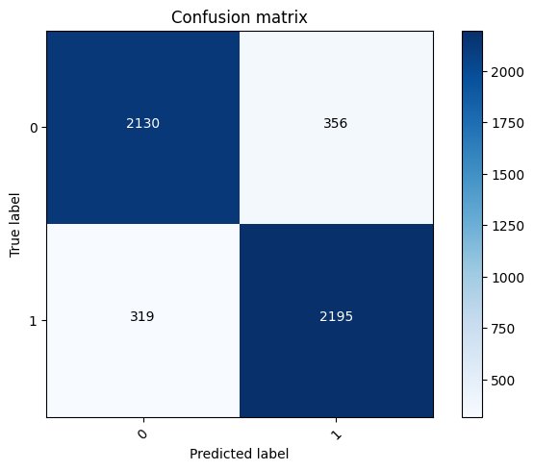
Ml with TF_IDF
Model | Accuracy | Precision | Recall | F1-score
Naive Bayes | 86% | 86% | 86% | 86%
Passive Aggressive | 87% | 87% | 87% | 87%

Slide 7

Ml with TF_IDF (Bigrams)
Passive Aggressive yields an accuracy of 90%, precision of 90%, recall of 90%, and an F1-score of 90%.

Slide 8

Ml with TF_IDF (Trigrams)
Passive Aggressive yields an accuracy of 90%, precision of 90%, recall of 90%, and an F1-score of 90%.

Slide 9
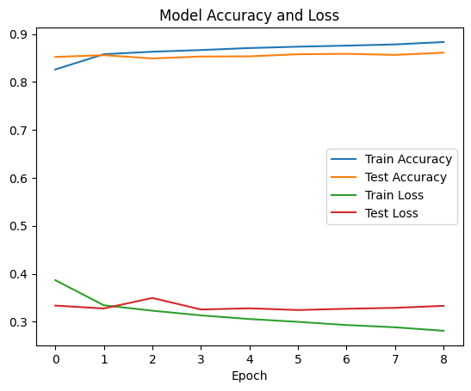
Neural network
Constructed a neural network comprising 5 hidden layers with ReLU activation and a dropout rate of 0.3.
Employed the Adam optimizer with a learning rate set to 0.001 to train the network.
Implemented early stopping to prevent overfitting during training.
Utilized TruncatedSVD to reduce the dimensionality of the data to 200 components.

Slide 10
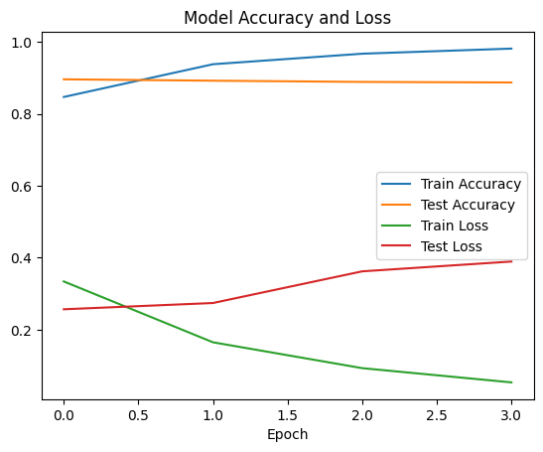
LSTM
Built an LSTM model incorporating an embedding layer, two LSTM layers, and dropout.
Employed Tokenizer for data tokenization and padding sequences, with a maximum sequence length set to 200.

Slide 11
Overview
The best models we have are:
Passive Aggressive with TF-IDF (Bigrams)
LSTM with Tokenizer
Both of them achieve an F1-score of 90%.

Slide 12
Thank you for
listening

